Slide 1
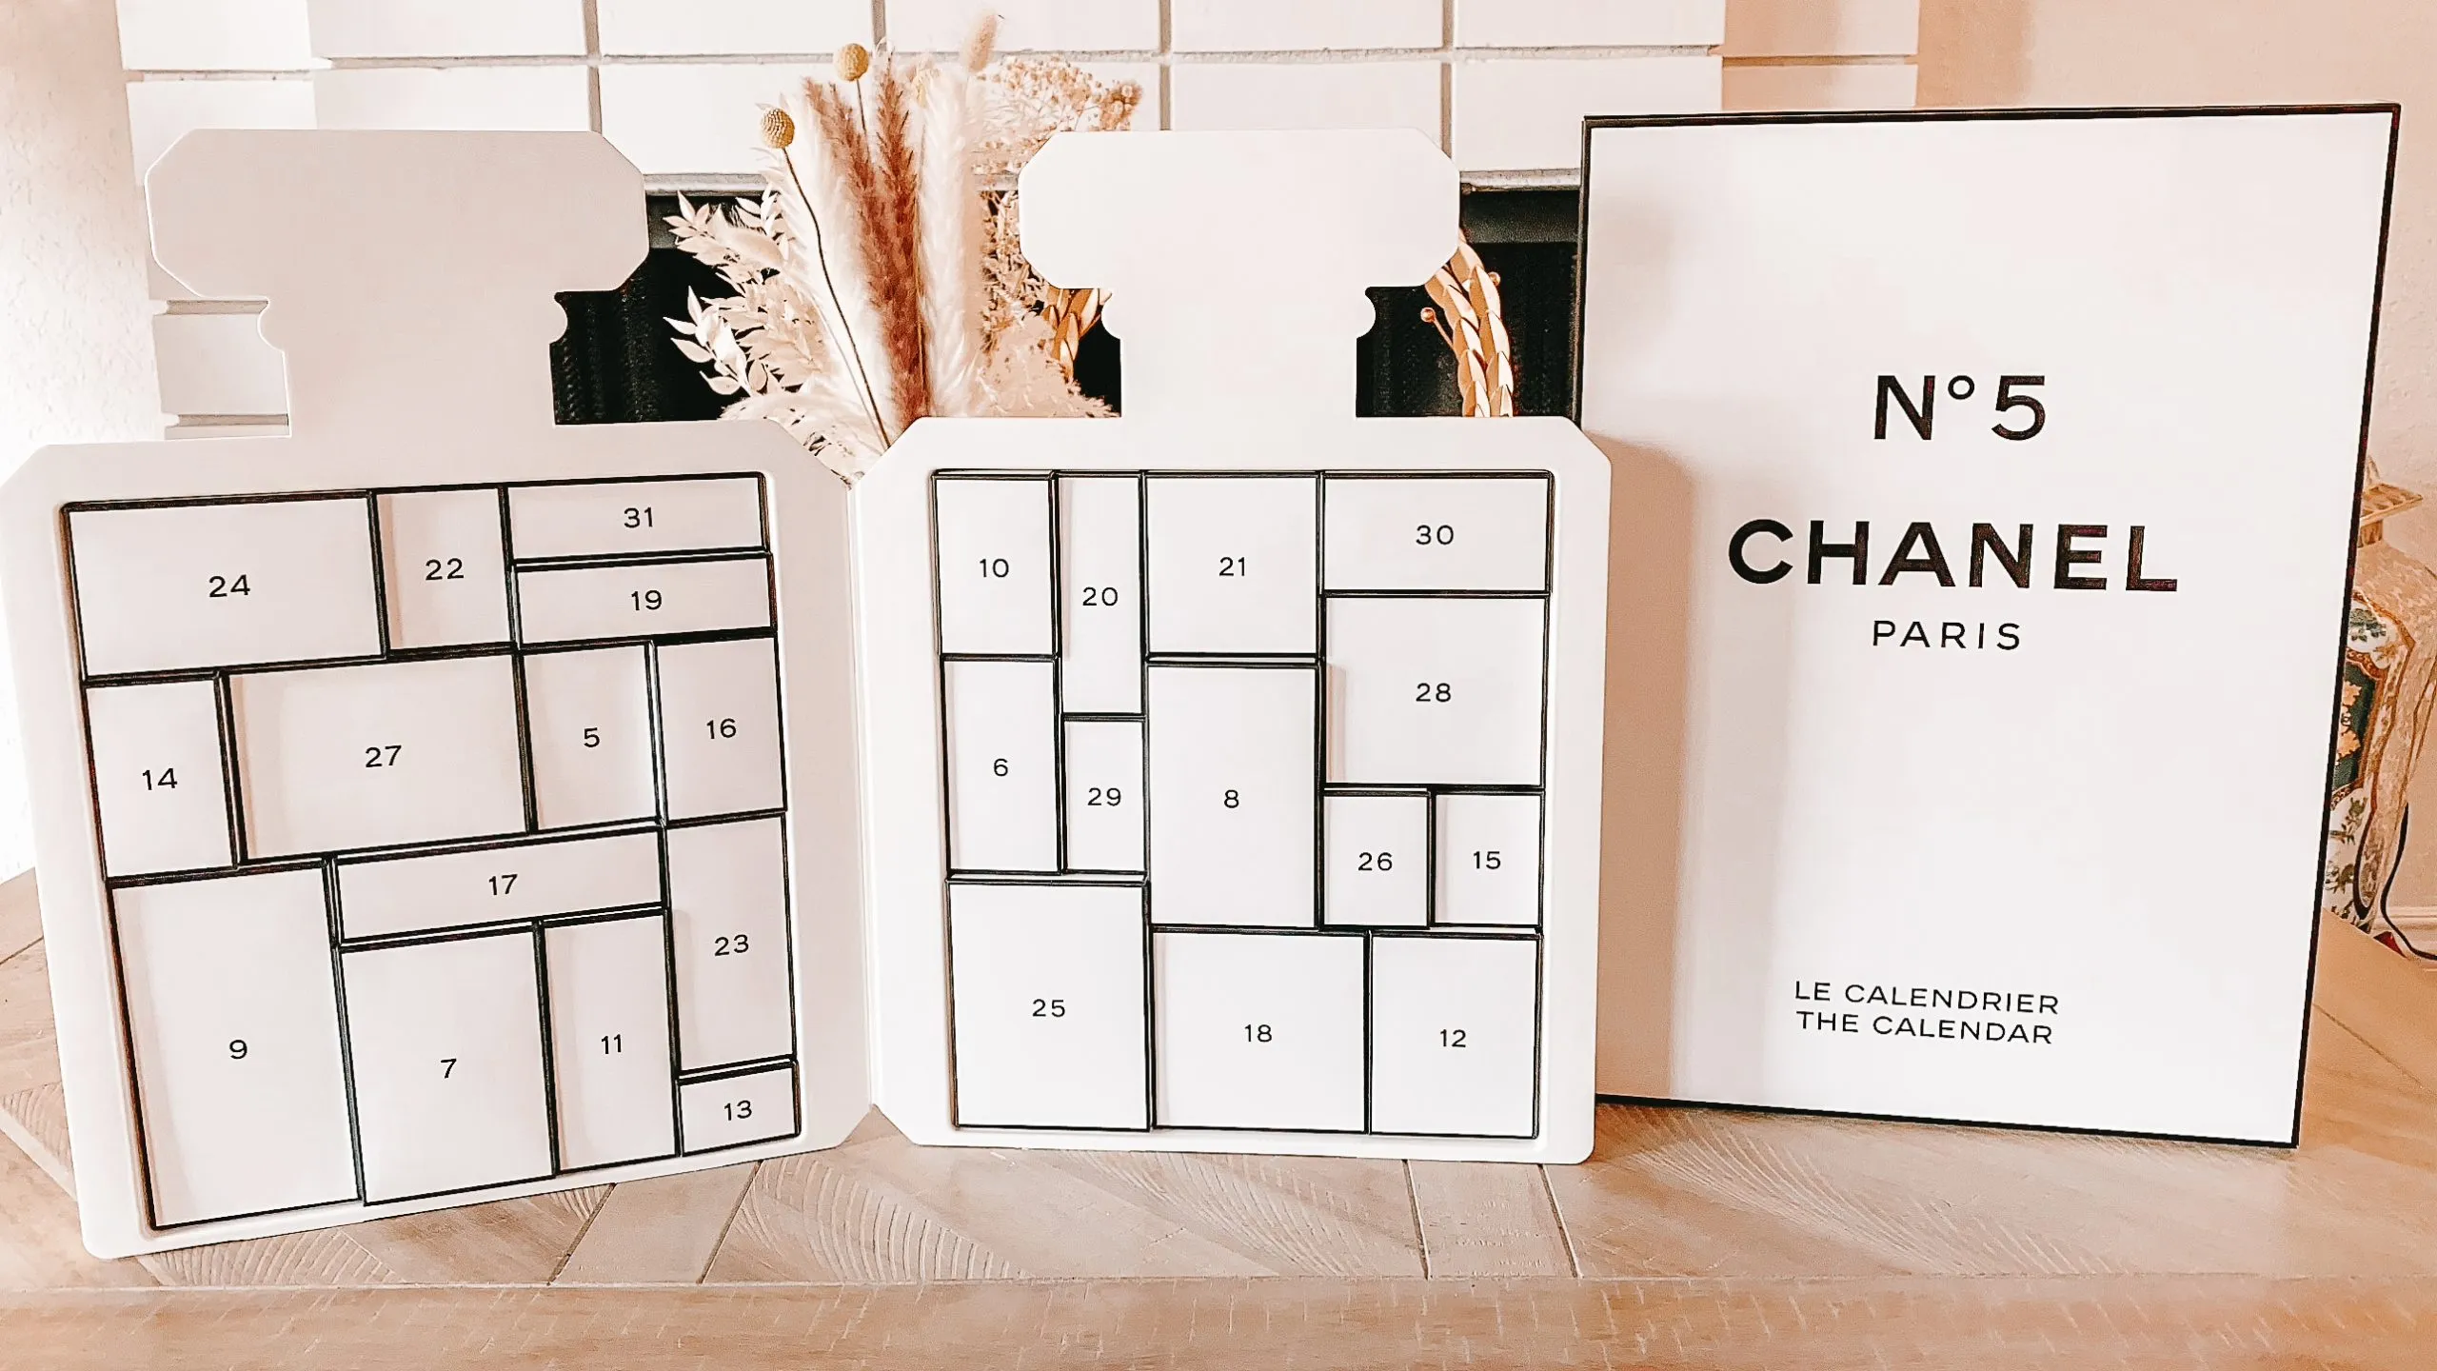
FINAL PROJECT SUMMARY
Strategic Redesign:
Chanel Advent Calendar 2025
Balancing Cost Efficiency and Customer Value: An MIP Approach

Slide 2
Global Market Survey: Customers Express Disappointment Over Chanel’s 2023 Advent Calendar Pricing
2024 Advent Calendar Launch Challenge: Historical Analysis and Strategic Planning
Customer Complaints
Cost-Value Imbalance
Supply Falls Short
Empty Compartments
Product Duplication
Substitute Products
Limited Product Diversity
Product Bundle Pricing Exceeds Individual Product Values
Ensuring Production Rate of Completed Advent Calendars
Storage Space Limitation for Semi-Finished Products
Strategic Solutions Framework: Enhancement Strategies
Customer Satisfaction
Financial Optimization
Supply Chain Management
100% product fill rate mandatory (no empty boxes)
Product Category Distribution Standards Established
Minimizing production costs while meeting quality standards
Resource allocation of 70-unit stock for each product across 100 calendar requirement

Slide 3
Individual Advent Calendar Optimization Framework: Objective, Decision Variables, Constraints
Objective
Decision Variables
Optimization Model Constraints
Product Identifier: Designation of individual items from Chanel's complete product assortment
Box Assignment: Specified daily position within the advent calendar (Days 1-31)
Decision Outcomes
Selected Placement (Value = 1): The designated product is allocated to the specified box position in a particular calendar unit
Non-Selection (Value = 0): The designated product is not assigned to the specified box position in a particular calendar unit
Analysis focuses on determining two distinct cost minimization scenarios for the Chanel Advent Calendar 2024:
1. Box Allocation Requirements
Each of the 31 boxes in the advent calendar must be assigned exactly one product.
2. Product Category Distribution Rules
Maximum of 3 identical products from large categories (Eyes, Lips, Fragrance)
No product duplication allowed within small categories
3. Niche Product Marketing Strategy
To introduce customers to new and unique products:
Minimum: 1 niche product per calendar
Maximum: 3 niche products per calendar
Scenario 1:
Individual Calendar Cost Minimization
The first objective is to identify the lowest possible cost for producing a single advent calendar, assuming unlimited products available.

Slide 4

Bulk Production Advent Calendar Optimization Framework: Objective, Decision Variables, Constraints
Objective
Decision Variables
Model Constraints
Scenario 2:
Bulk Production Cost Minimization
The second objective is to determine the minimum cost per calendar when producing 100 units, considering real-world inventory constraints of 70 units per product.
Product Identifier: Designation of individual items from Chanel's complete product assortment
Box Assignment: Specified daily position within the advent calendar (Days 1-31)
Production Sequence: Individual calendar identification within total production quantity (Units 1-100)
Resource Allocation Constraints for Large-Scale Production:
4. Inventory Management Constraints
Each product type has a fixed inventory of 70 units.
Target allocation volume: 100 advent calendars.

Slide 5

MIP Optimization Model: Overview and Purpose
What the Model Accomplishes?
The MIP model optimizes the selection of 31 products (one for each day of an Advent Calendar) from a predefined list of Chanel makeups, minimizing cost of products.
For a single advent calendar, the model provides details including box number, items, categories, product prices, and the minimum advent calendar price.
For bulk production, the model summarizes the results by showing product counts per category and the advent calendar’s minimum total price.
Who are the Target Audiences?
Luxury Beauty Brands & Retailers:
Use this model to design their Advent Calendars.
Product Managers and Marketers:
Promote niche or lesser-known items in an engaging way.
Operations and Supply Chain Teams:
Ensure efficient resource allocation within inventory and cost constraints.

Slide 6

MIP Optimization Model: Overview and Purpose
Why is the Model Valuable?
Cost Efficiency:
Minimizes costs while maintaining quality and variety.
Product Diversity:
Prevents dominance of any product type, enhancing customer satisfaction.
Promotion of Niche Products:
Highlights lesser-known products to drive future sales.
Scalability:
Adaptable to other products and production.
e.g. Seasonal Gift Boxes
Best Beauty: Lipsticks

Slide 7
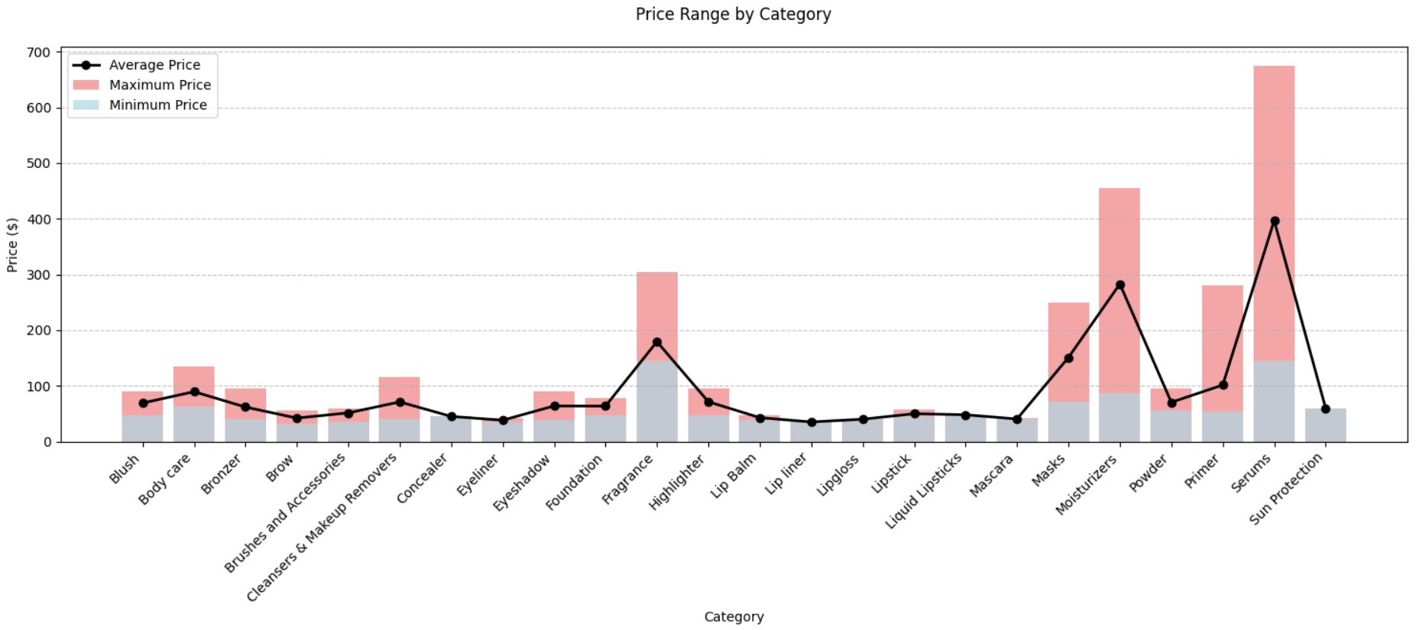
Data Visualization
Strategic Category Management for Advent Calendar
By strategically positioning premium products like Serums ($400-675) and Fragrances ($145-305) on special dates (e.g. beginning or end of the month) of the advent calendar, Chanel can maximize customer anticipation and perceived value.
Chanel can place high-margin categories in to the advent calendar like Serums and Fragrance for premium offerings while using Lip products and Eyeliner for cost-effective options.

Slide 8
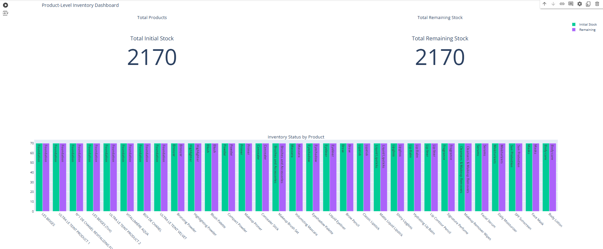
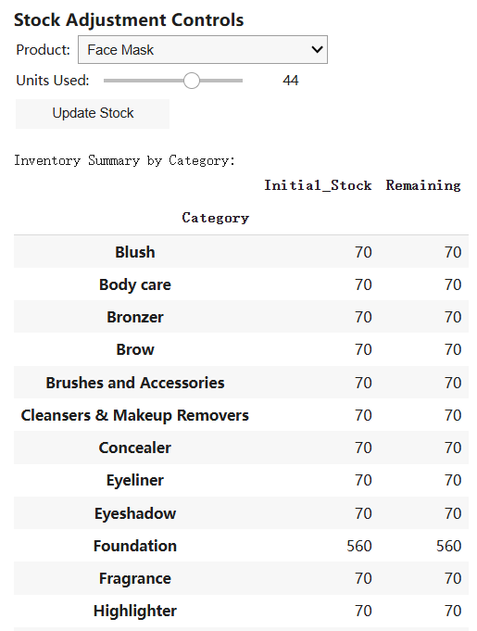
Additional Research: Interactive Inventory Management Interface for Optimization Model Refinement
We developed a streamlined interface for tracking warehouse stock levels. This interface works in conjunction with our Mixed Integer Programming (MIP) optimization model for the advent calendar product selection. While not a real-time monitoring system, it allows users to input and update current inventory levels. By maintaining visibility of available stock, we can dynamically adjust the optimization parameters, ensuring that the model's solutions remain feasible within actual warehouse capacity limitations.

Slide 9
Google Colab Implementation Links
MIP Optimization Model:
https://colab.research.google.com/drive/18J85iAVNn7G90iJncaO0iDtoOF_O9Vta?usp=sharing
Data Visualization:
https://colab.research.google.com/drive/1Rcx0xvpRD497WV4yHflH29Xb5VgqHwiK?usp=sharing
Interactive Inventory Management Interface:
https://colab.research.google.com/drive/1f35N2ANN2MVJf5O1LjAiw_J8PYeiyx9G?usp=sharing
Data:
The data have been sourced directly from the official Chanel website.
Thanks for Watching

